Slide 1

Effects of Outside Temperature on Restaurant Popularity (2019)
Group Members
Adeola Ojegbile
Brandon Su
Isaac Carranza
Jungje Son
Notes:
12) R-Value Thai | 13) R-Value Japanese | 14) No good R-Value for any cuisine
1-5: Isaac | 6-7: Brandon, Jung | 8-18: Isaac
19-21: Addy | 22-26: Isaac

Slide 2
Summary
Objective: Sought to find correlations between average monthly temperature and popularity of certain restaurant categories.
Overall Hypothesis: Outside temperature does impact how popular a restaurant is during that time.
Question Overview:
Will temp. have a positive impact on popularity? Negative impact?
Which category is most popular in hot temp.? Cold temp.?
Results Overview:
Mixed results. Some hypothesis confirmed others rejected.
Notes:
12) R-Value Thai | 13) R-Value Japanese | 14) No good R-Value for any cuisine
1-5: Isaac | 6-7: Brandon, Jung | 8-18: Isaac
19-21: Addy | 22-26: Isaac

Slide 3
Questions & Data
Q1: Will any restaurant category show a positive impact on popularity based average monthly temperature?
Q2: Will any restaurant category show a negative impact on popularity based average monthly temperature?
Q3: What restaurant categories are the most popular in hot temperatures?
Q4: What restaurant categories are the most popular in cold temperatures?
Notes:
12) R-Value Thai | 13) R-Value Japanese | 14) No good R-Value for any cuisine
1-5: Isaac | 6-7: Brandon, Jung | 8-18: Isaac
19-21: Addy | 22-26: Isaac

Slide 4
Questions & Data
Data Needed:
Consistent weather data for all of 2019
Yelp check-ins by restaurant category
Data Acquired From:
Weather:
Meteostat API - https://meteostat.net/en
Restaurant Check-ins:
Yelp Open Dataset - https://www.yelp.com/dataset
Yelp Fusion API - https://www.yelp.com/fusion
Notes:
12) R-Value Thai | 13) R-Value Japanese | 14) No good R-Value for any cuisine
1-5: Isaac | 6-7: Brandon, Jung | 8-18: Isaac
19-21: Addy | 22-26: Isaac

Slide 5
Data Cleanup & Exploration
Exploration & Cleanup
Insights
Problems & Resolutions
Interesting Findings
Notes:
12) R-Value Thai | 13) R-Value Japanese | 14) No good R-Value for any cuisine
1-5: Isaac | 6-7: Brandon, Jung | 8-18: Isaac
19-21: Addy | 22-26: Isaac

Slide 6
Data Cleanup & Exploration
Yelp API: No check-in data
Resolution: Use Yelp Open Dataset for check-ins and combined with more data from Yelp Fusion API
Yelp Data: Combined data didn’t provide cities needed (LA, SF, NY)
Resolution: Chose from available cities far enough apart to be different.
Yelp Categories: Inconsistent or difficult to group
e.g.: Chinese, Thai, Sea Food, American, BBQ, Café
Resolution: Discarded some data, combined others
Notes:
12) R-Value Thai | 13) R-Value Japanese | 14) No good R-Value for any cuisine
1-5: Isaac | 6-7: Brandon, Jung | 8-18: Isaac
19-21: Addy | 22-26: Isaac

Slide 7
Data Cleanup & Exploration
OpenWeather API: No historical data
Resolution: Used Meteostat API
Meteostat: Couldn't search based on city
Resolution:
Used their interactive map to locate weather stations within the cities of interest
From there, leveraged API to pull necessary weather data.
Notes:
12) R-Value Thai | 13) R-Value Japanese | 14) No good R-Value for any cuisine
1-5: Isaac | 6-7: Brandon, Jung | 8-18: Isaac
19-21: Addy | 22-26: Isaac

Slide 8
Data Analysis
Notes:
12) R-Value Thai | 13) R-Value Japanese | 14) No good R-Value for any cuisine
1-5: Isaac | 6-7: Brandon, Jung | 8-18: Isaac
19-21: Addy | 22-26: Isaac

Slide 9
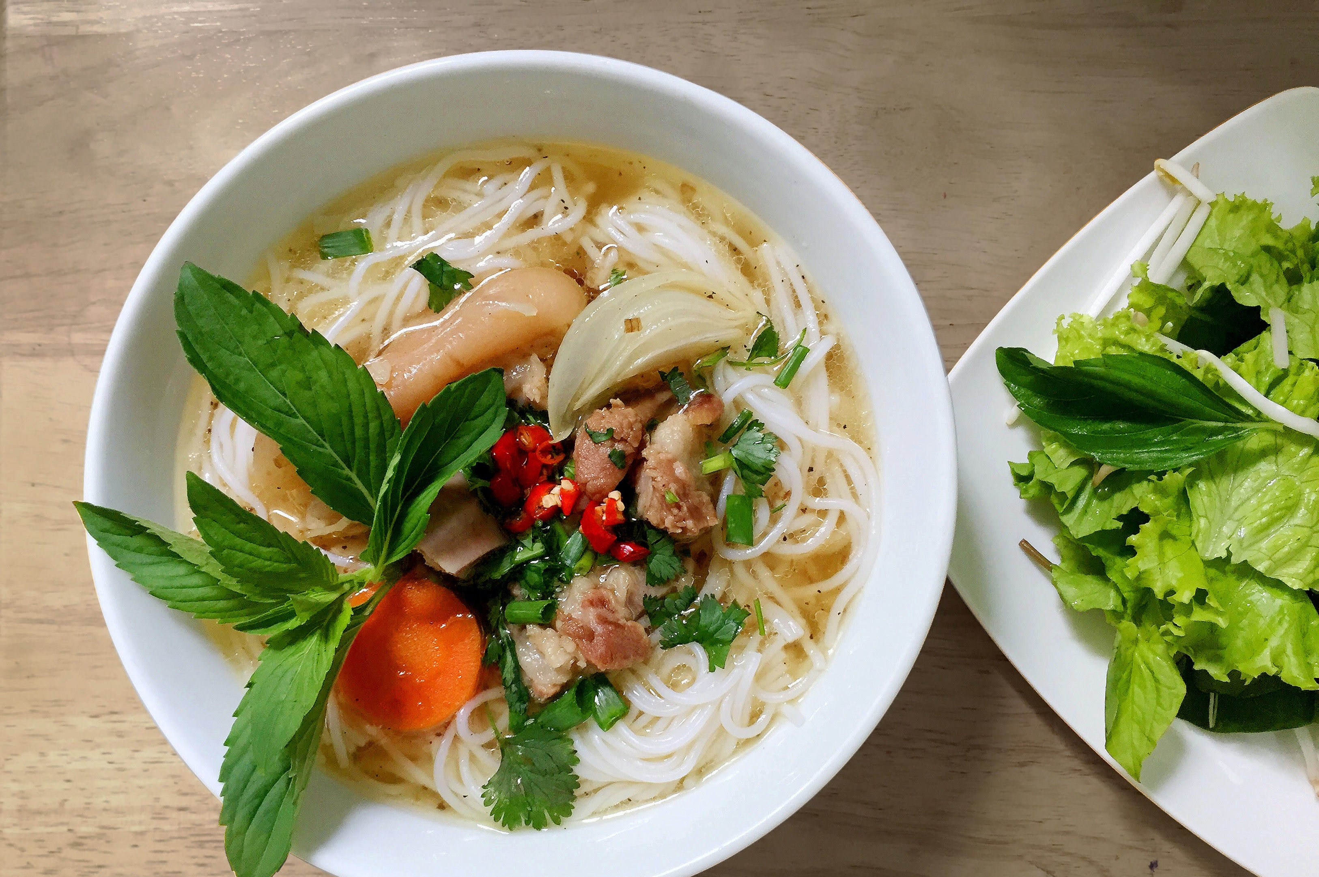
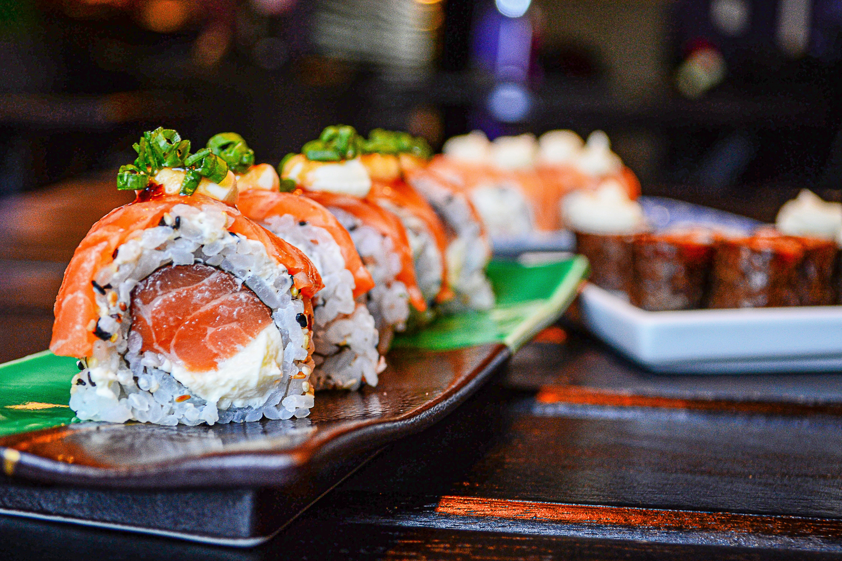
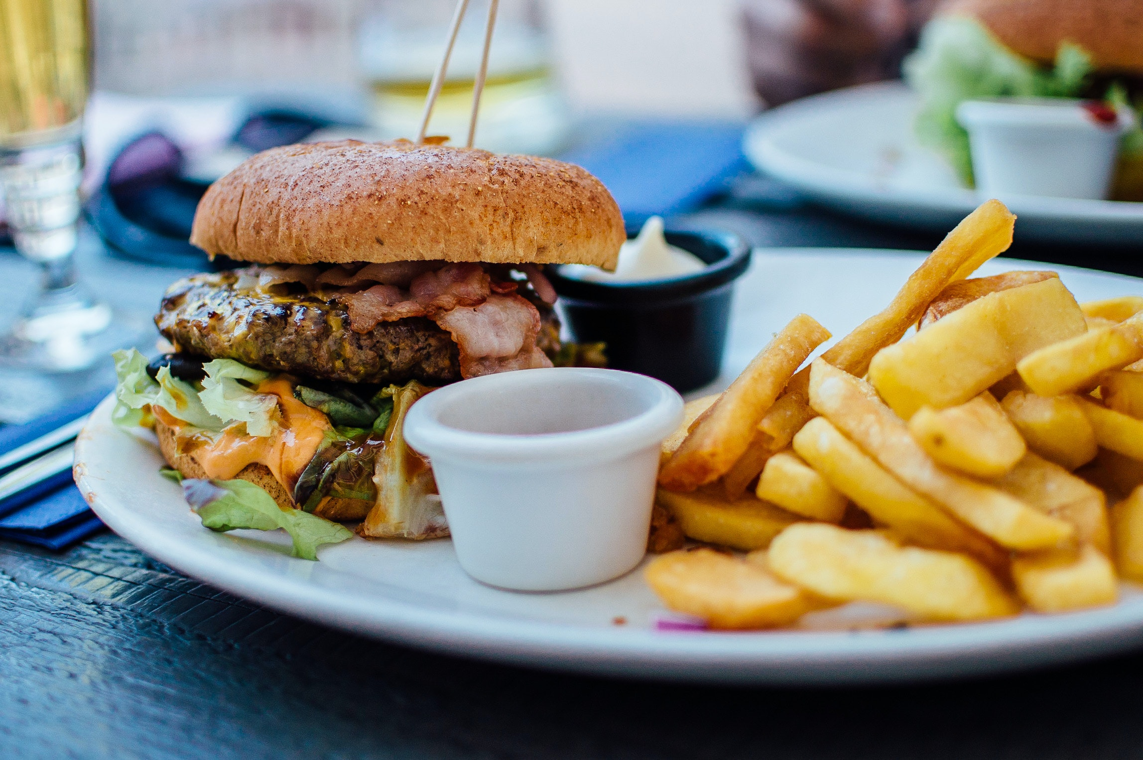
Restaurant Categories
Thai
Japanese
American
Notes:
12) R-Value Thai | 13) R-Value Japanese | 14) No good R-Value for any cuisine
1-5: Isaac | 6-7: Brandon, Jung | 8-18: Isaac
19-21: Addy | 22-26: Isaac

Slide 10
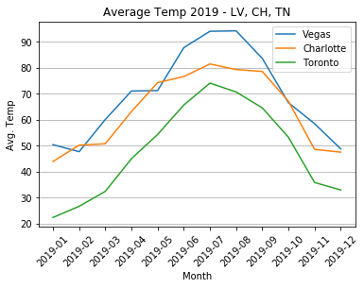

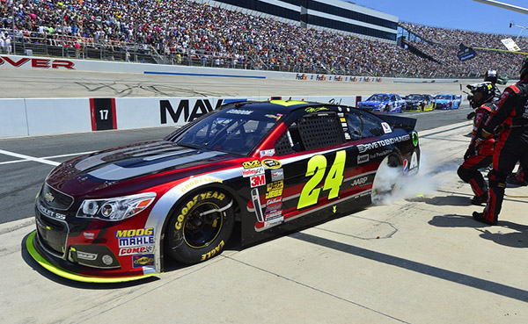

Cities
Las Vegas
Charlotte
Toronto
Notes:
12) R-Value Thai | 13) R-Value Japanese | 14) No good R-Value for any cuisine
1-5: Isaac | 6-7: Brandon, Jung | 8-18: Isaac
19-21: Addy | 22-26: Isaac

Slide 11
Data Analysis
Q1: Will any restaurant category show a positive impact on popularity based average monthly temperature?
Hypothesis: A restaurant category will show a positive impact on popularity based average monthly temperature.
Null: Average monthly temperature has no impact on popularity based average monthly temperature.
Results: Hypothesis confirmed. There is strong evidence that temperature has a positive impact on restaurant popularity, except in Charlotte.
Notes:
12) R-Value Thai | 13) R-Value Japanese | 14) No good R-Value for any cuisine
1-5: Isaac | 6-7: Brandon, Jung | 8-18: Isaac
19-21: Addy | 22-26: Isaac

Slide 12
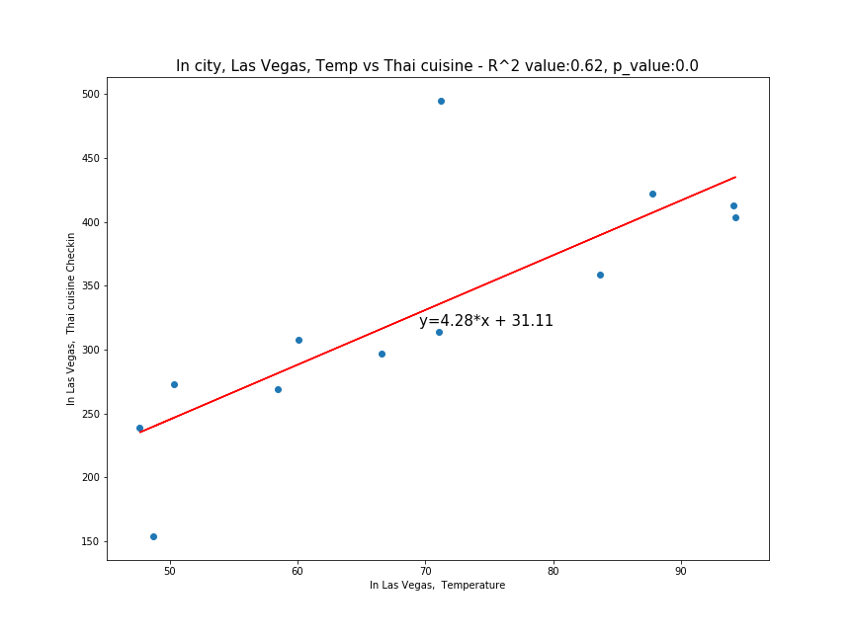
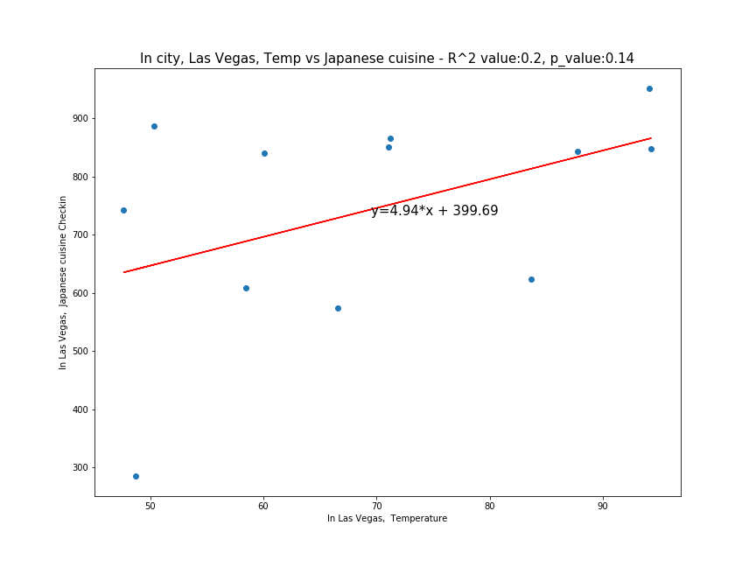
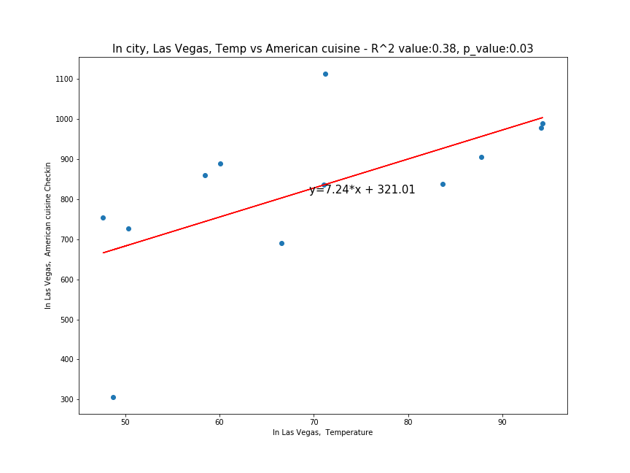
Data Analysis
Results: Hypothesis confirmed. There is strong evidence that temperature (in this case, warmer temperatures) has a positive impact on restaurant popularity, except in Charlotte.
Las Vegas
Notes:
12) R-Value Thai | 13) R-Value Japanese | 14) No good R-Value for any cuisine
1-5: Isaac | 6-7: Brandon, Jung | 8-18: Isaac
19-21: Addy | 22-26: Isaac

Slide 13
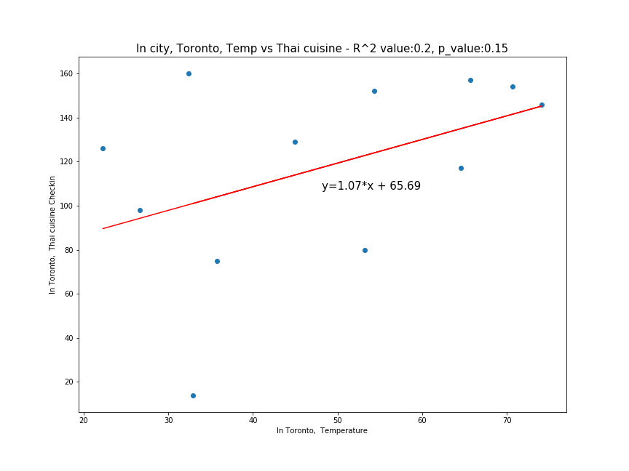
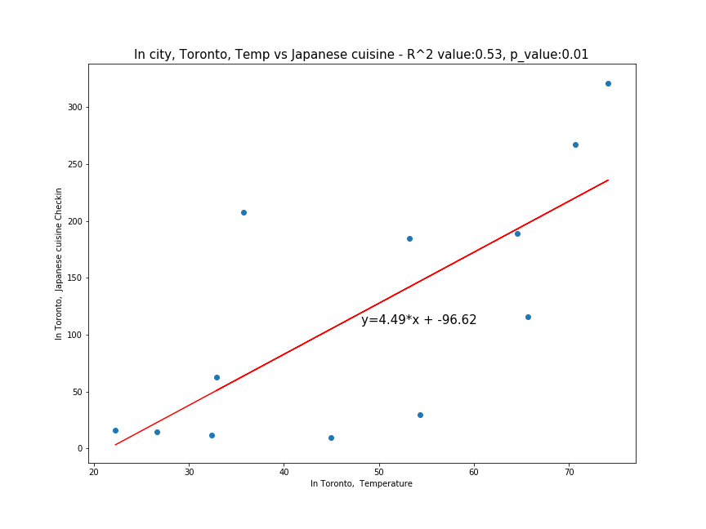
Data Analysis
Results: Hypothesis confirmed. There is strong evidence that temperature (in this case, warmer temperatures) has a positive impact on restaurant popularity, except in Charlotte.
Toronto
Notes:
12) R-Value Thai | 13) R-Value Japanese | 14) No good R-Value for any cuisine
1-5: Isaac | 6-7: Brandon, Jung | 8-18: Isaac
19-21: Addy | 22-26: Isaac

Slide 14
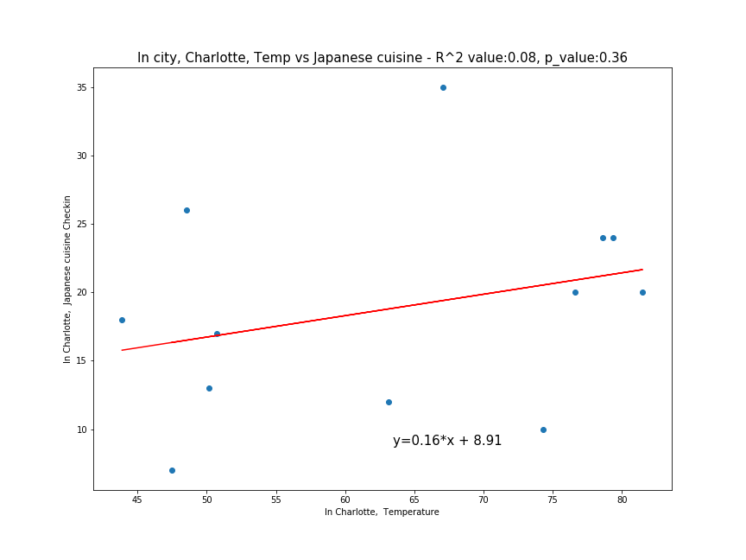
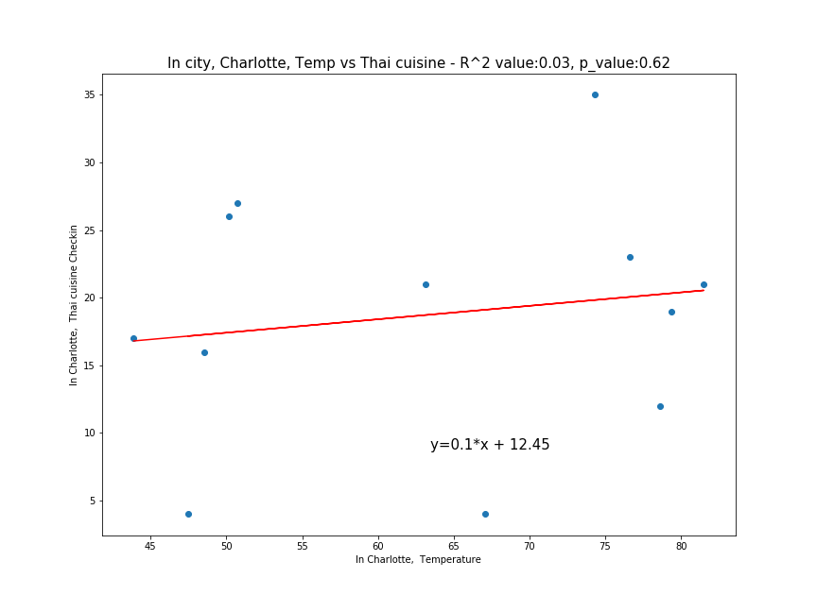
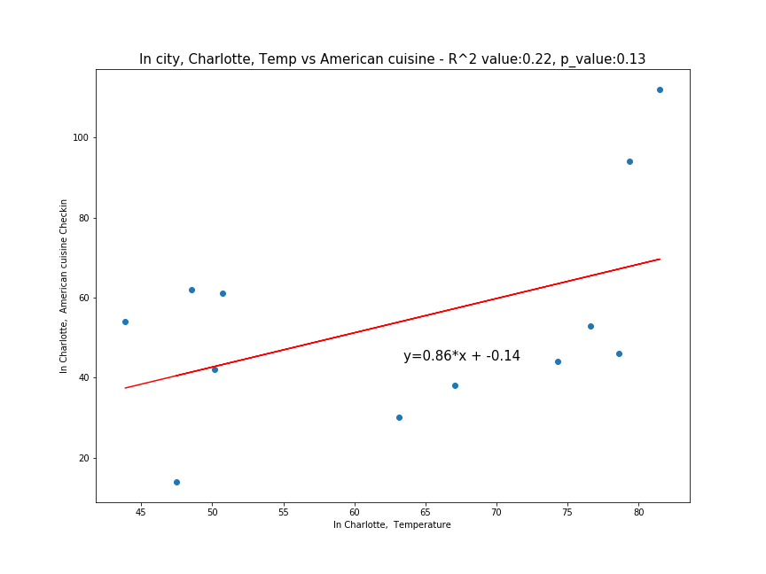
Data Analysis
Results: Hypothesis confirmed. There is strong evidence that temperature (in this case, warmer temperatures) has a positive impact on restaurant popularity, except in Charlotte.
Charlotte
Notes:
12) R-Value Thai | 13) R-Value Japanese | 14) No good R-Value for any cuisine
1-5: Isaac | 6-7: Brandon, Jung | 8-18: Isaac
19-21: Addy | 22-26: Isaac

Slide 15
Data Analysis
Q2: Will any restaurant category show a negative impact on popularity based average monthly temperature?
Hypothesis: A restaurant category in each city will show a negative impact on popularity based average monthly temperature.
Null: Average monthly temperature has no impact on popularity based average monthly temperature.
Results: Hypothesis not confirmed. None of our categories showed a negative impact on popularity based average monthly temperature, therefore we could not reject the Null.
Notes:
12) R-Value Thai | 13) R-Value Japanese | 14) No good R-Value for any cuisine
1-5: Isaac | 6-7: Brandon, Jung | 8-18: Isaac
19-21: Addy | 22-26: Isaac

Slide 16
Data Analysis
Q3: What restaurant categories are the most popular in hot weather?
Hypothesis: American food with be the most popular in hot weather.
Null: There is no difference in popularity among restaurant categories based on hot weather.
Results: Hypothesis confirmed. American restaurants have the most check-ins in hot weather. We confirmed that this is not by chance based on chi-square analysis. However, In Las Vegas, every category got more check-ins in hot weather. Our dataset did not have any American restaurants in Toronto; therefore, Toronto was excluded in this analysis.
Notes:
12) R-Value Thai | 13) R-Value Japanese | 14) No good R-Value for any cuisine
1-5: Isaac | 6-7: Brandon, Jung | 8-18: Isaac
19-21: Addy | 22-26: Isaac

Slide 17
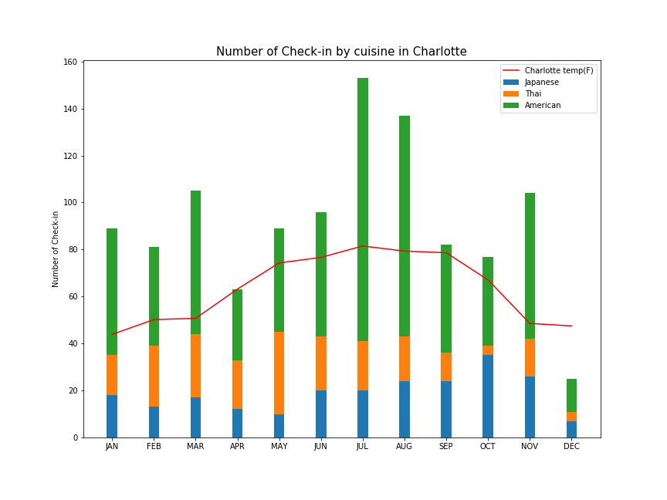
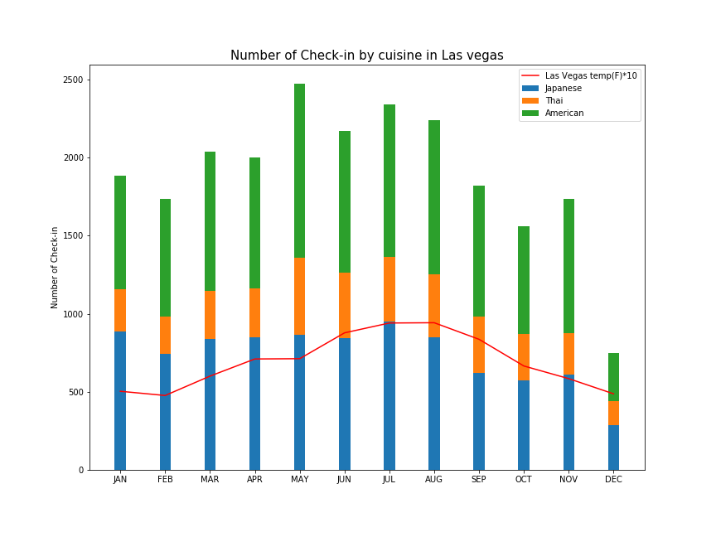
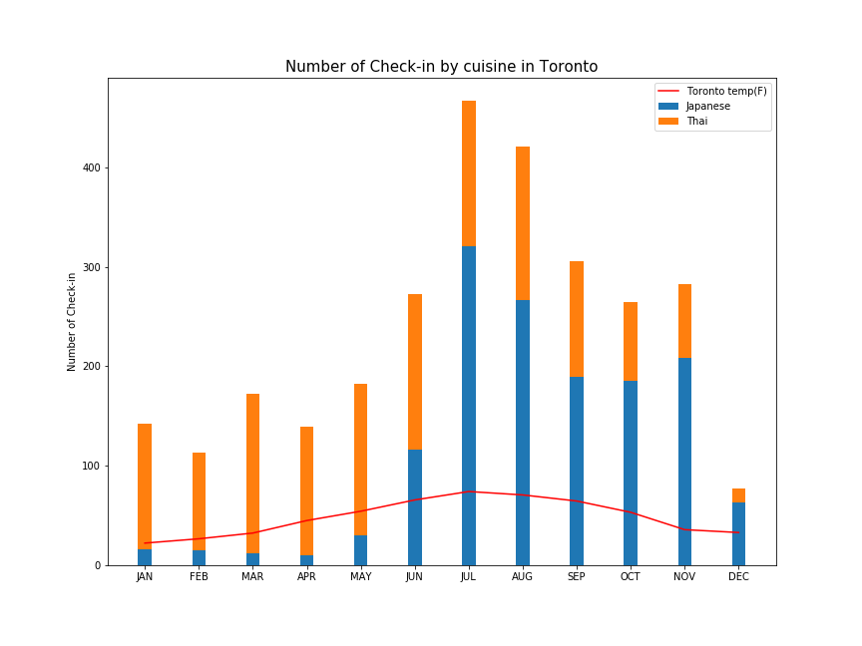
Data Analysis
Results: Hypothesis confirmed. American restaurants have the most check-ins in hot weather. However, In Las Vegas, every category got more check-ins in hot weather. *Our dataset did not have any American restaurants in Toronto.
Notes:
12) R-Value Thai | 13) R-Value Japanese | 14) No good R-Value for any cuisine
1-5: Isaac | 6-7: Brandon, Jung | 8-18: Isaac
19-21: Addy | 22-26: Isaac

Slide 18
Data Analysis
Q3: What restaurant categories are the most popular in hot weather?
Results: Hypothesis confirmed using chi-square. American restaurants have the most check-ins in hot weather.
Las Vegas: American and Japanese
(stat=336.09, p-value=2.12) chi^^2 value: 336.09 and critical value: 10.34
Las Vegas: American and Thai
(stat=9406.60, p-value=0.0) chi^^2 value: 9406.6 and critical value: 10.34
In Charlotte: American and Japanese
(stat=1152.26, p-value=3.14) chi^^2 value: 1152.26 and critical value: 10.34
In Charlotte: American and Thai
(stat=1411.46, p-value=4.05) chi^^2 value: 1411.46 and critical value: 10.34
Notes:
12) R-Value Thai | 13) R-Value Japanese | 14) No good R-Value for any cuisine
1-5: Isaac | 6-7: Brandon, Jung | 8-18: Isaac
19-21: Addy | 22-26: Isaac

Slide 19
Data Analysis
Q4: What restaurant categories are the most popular in cold weather?
Hypothesis: Thai food with be the most popular in cold weather.
Null: There is no difference in popularity among restaurant categories based on cold weather.
Results: Hypothesis not confirmed. We found that the answer varies per city. In our dataset, Toronto did not have American category listed. However, Thai was significantly more popular than Japanese based on check-ins during its coldest months. Toronto was the only city that “confirmed” our hypothesis.
Notes:
12) R-Value Thai | 13) R-Value Japanese | 14) No good R-Value for any cuisine
1-5: Isaac | 6-7: Brandon, Jung | 8-18: Isaac
19-21: Addy | 22-26: Isaac

Slide 20
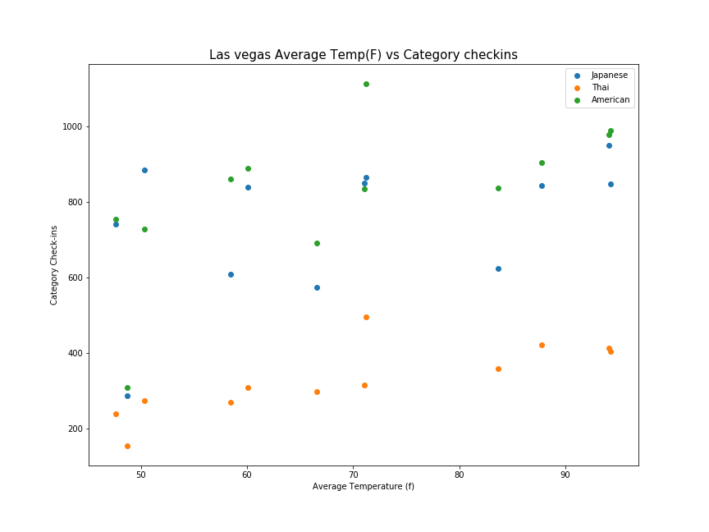
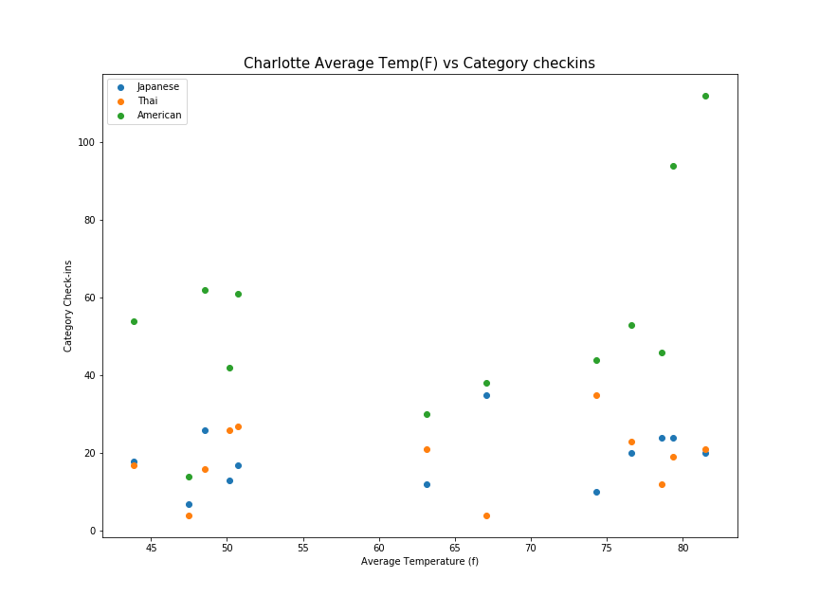
Data Analysis
Results: Hypothesis not confirmed. We found that the answer varies per city.
Notes:
12) R-Value Thai | 13) R-Value Japanese | 14) No good R-Value for any cuisine
1-5: Isaac | 6-7: Brandon, Jung | 8-18: Isaac
19-21: Addy | 22-26: Isaac

Slide 21
Data Analysis
Results: Toronto was the only city that “confirmed” our hypothesis.
Notes:
12) R-Value Thai | 13) R-Value Japanese | 14) No good R-Value for any cuisine
1-5: Isaac | 6-7: Brandon, Jung | 8-18: Isaac
19-21: Addy | 22-26: Isaac

Slide 22
Discussion
We expected to find that the popularity of restaurants would increase during warmer weather—specifically American cuisine.
We found this to be true across all restaurant categories in Las Vegas. Possibly do to increased visitors during the summer months.
Notes:
12) R-Value Thai | 13) R-Value Japanese | 14) No good R-Value for any cuisine
1-5: Isaac | 6-7: Brandon, Jung | 8-18: Isaac
19-21: Addy | 22-26: Isaac

Slide 23
Post Mortem
Notes:
12) R-Value Thai | 13) R-Value Japanese | 14) No good R-Value for any cuisine
1-5: Isaac | 6-7: Brandon, Jung | 8-18: Isaac
19-21: Addy | 22-26: Isaac

Slide 24
Post Mortem
As discussed prior, we encountered several challenges during our exploration and data cleanup.
Found alternatives, combined data resources , and adjusted our variables such as cities and restaurant types.
Limited data/sample size
Zoom interruptions (free account)
Kept reconnecting and moving forward
Notes:
12) R-Value Thai | 13) R-Value Japanese | 14) No good R-Value for any cuisine
1-5: Isaac | 6-7: Brandon, Jung | 8-18: Isaac
19-21: Addy | 22-26: Isaac

Slide 25
Post Mortem
With more time:
more API pulls (daily limit)
Find larger datasets
More effective categorization
More in-depth analysis
Notes:
12) R-Value Thai | 13) R-Value Japanese | 14) No good R-Value for any cuisine
1-5: Isaac | 6-7: Brandon, Jung | 8-18: Isaac
19-21: Addy | 22-26: Isaac

Slide 26
Q & A
Notes:
12) R-Value Thai | 13) R-Value Japanese | 14) No good R-Value for any cuisine
1-5: Isaac | 6-7: Brandon, Jung | 8-18: Isaac
19-21: Addy | 22-26: Isaac

